Slide 1



Azure SQL Database Elasticity Room 1 – 9:45 Session
Welcome to Data Saturday #13
Minnesota
Steve Hughes

Slide 2


Thank You to our Sponsors!
Gold:
Please patronize our sponsors and thank them for sponsoring! We couldn’t run events like these without the support.

Slide 3

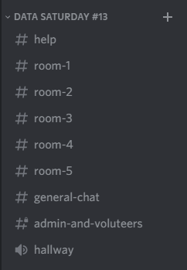

Join The PASSMN Discord Server
https://discord.gg/GajGTFVT28
We’re using Discord as our background chat and communication platform to augment our Virtual Events. This way you can chat with all attendees and continue the conversation after the sessions/event.
Note: Change your Nickname to your First & Last Name so it’s easier to know who you are.
Help Chat:
Session Chat & Q/A:
Example:
Voice Chat:

Slide 4
Azure SQL Database Elasticity
Queries
Jobs &
Transactions
Steve Hughes

Slide 5


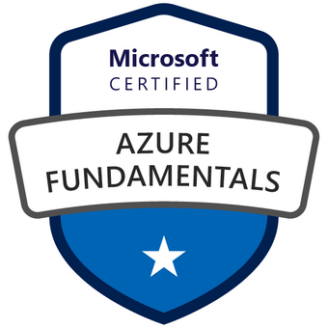


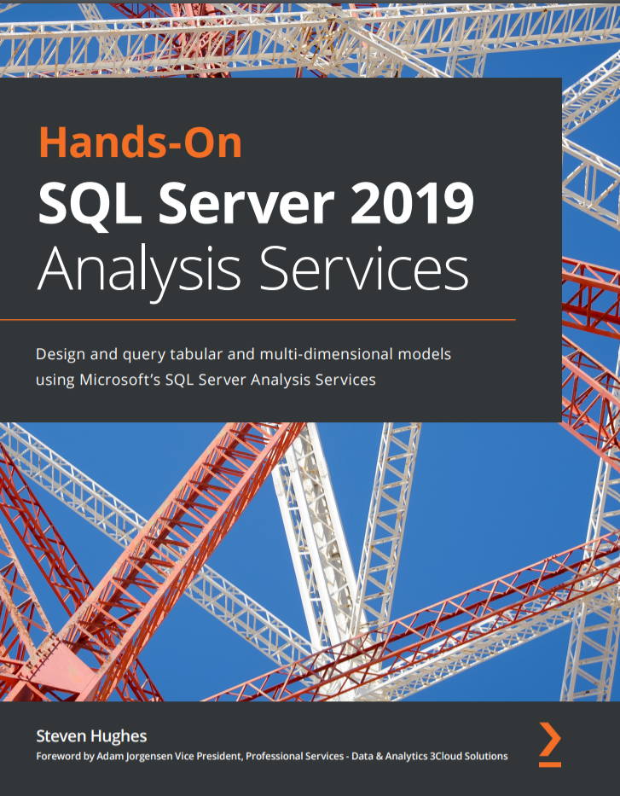
Steve Hughes
3Cloud is hiring!
Senior Director, Data & Analytics, 3Cloud
20+ Years with SQL Server, Microsoft BI, and Azure
https://www.linkedin.com/in/dataonwheels/
steve@dataonwheels.com
Blog: www.dataonwheels.com – Look for deck and follow up on the blog

Slide 6
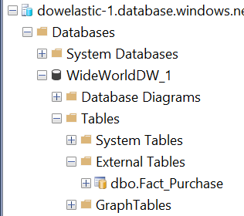
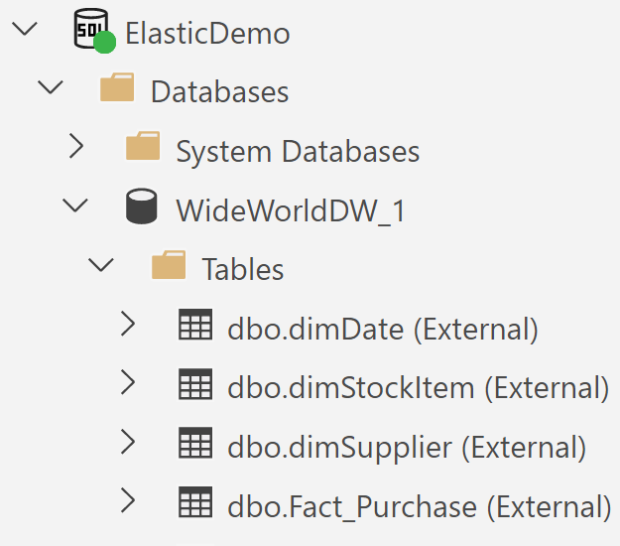
Elastic Queries
SSMS
Elastic Queries are similar to Polybase functionality found in SQL Server 2019 and Azure Synapse
They allow developers to distribute query workloads across Azure SQL Databases by distributing the data
If you are familiar with Polybase, you will see the same external table syntax used here without the additional connection complexity
Included in the cost of Azure SQL Database in standard and premium tiers
This functionality is still in preview
Reference: https://docs.microsoft.com/en-us/azure/azure-sql/database/elastic-query-overview
Azure Data Studio

Slide 7
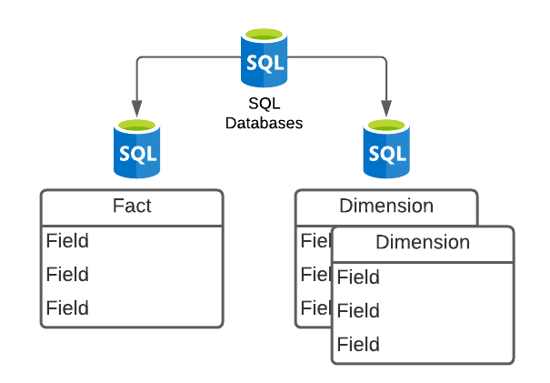
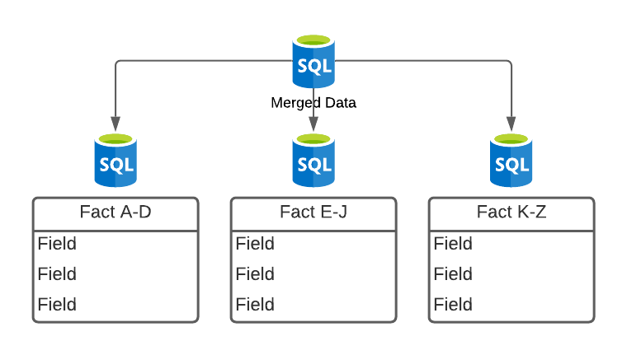
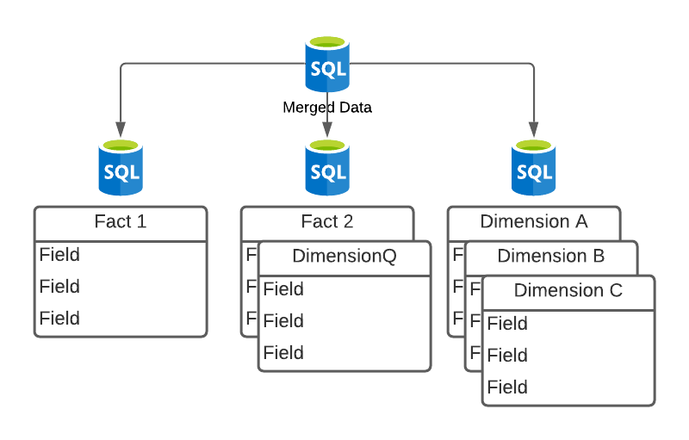
Elastic Queries Strategies
Vertical partitioning – Complete tables in separate databases. Can be shared table such as date tables or even dimensions. Allows us to create scale the data solution out.
Horizontal Partitioning or Sharding – Pieces of a larger table are distributed across multiple databases and pulled together in an elastic query. Requires a shard map. Typically implemented with .NET or Java applications.
Data virtualization – Bringing data from different solutions together into a single database. This is an overall concept. Virtualizing data in a single database access point.

Slide 8
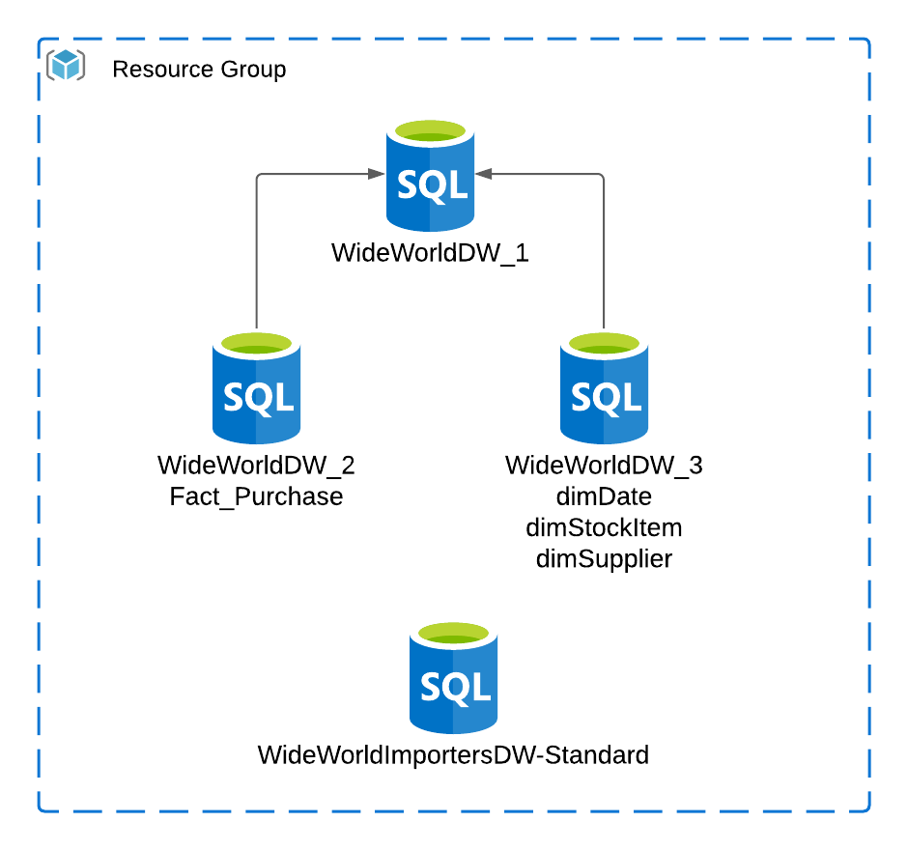
Demo Configuration – Vertical or Virtualization
Three S1 Azure SQL Databases on the same Azure SQL Server
S2 Azure SQL Database created when restoring WideWorldImportersDW
ADF used to move Fact.Purchase to WideWorldDW_2 and the three related dimensions to WideWorldDW_3
WideWorldDW_1 is set up to query both WideWorldDW_2 and WideWorldDW_3 as external data sources.

Slide 9
Elastic Query Final Thoughts
Still in preview
Only use with Azure SQL Database and Azure Synapse
Costs
Included in the price of Azure SQL Database
Standard starts up slower than premium
Data center distribution will incur egress costs
Read-only currently supported, writes through external table connections are not supported
Not optimized for ETL operations, should be limited to reporting or cross database querying needs

Slide 10

Elastic Jobs (Preview)
Provides a mechanism to support T-SQL scripts to be run across one or more databases in parallel, on demand or on a schedule
Requires a dedicated “job database”
Jobs are “free”, the job database is not
A job is a collection of job steps which are SQL statement to be executed against the specified target
Jobs can be created in the portal, with Powershell, with REST, or with SQL
Reference: https://docs.microsoft.com/en-us/azure/azure-sql/database/elastic-jobs-overview

Slide 11
Elastic Job Targets and Steps
Target Groups
Jobs and Job Steps
Databases
One or more can be added to a group
Server
Target all the databases in the server
Pools and Shard Maps can be targeted as well
A job contains one or more steps
A job step is a unit of work to be done which is defined with TSQL
Jobs can be executed on demand or on a schedule
Job history is stored with detail for 45 days

Slide 12
Elastic Job Demo
New database added – S0 minimum to be the job database - ElasticJobDb
Elastic Job agent created using the portal – passmndemo
T-SQL used to create and manage target groups, jobs, and job steps
Two Groups
Two Jobs

Slide 13
Elastic Transactions (Preview)
Allows you to create cross database transactions in Azure SQL Database or Azure SQL Managed Instance
Replaces MSDTC in PaaS, built into Azure SQL Database, no additional components required
Application driven - .NET library supported in the current version
Supports transactions that span databases and servers with PowerShell
Supports sharded database applications which need atomic control in the transactions
Supports transactions across fewer than 100 databases well, no limit, but performance can suffer

Slide 14
Elastic Transactions Limitations
Only supports Azure SQL Databases and Managed Instance
The set of databases cannot be mixed, either SQL Databases or Managed Instances
.NET transactions or client-side transactions are supported in either SQL Databases or Managed Instances (not mixed)
T-SQL or server-side distributed transactions (e.g. BEGIN DISTRIBUTED TRANSACTION) are only supported in Managed Instance
Transactions across WCF are not supported
Reference: https://docs.microsoft.com/en-us/azure/azure-sql/database/elastic-transactions-overview

Slide 15
Resources for the Demos
Sample databases: https://github.com/Microsoft/sql-server-samples/releases/tag/wide-world-importers-v1.0
Code can be found on github at https://github.com/DataOnWheels/codeshare/tree/master/datasat13mn-azureelasticity
Azure Data Factory jobs not included here. Use the Copy Tasks to move the tables to the target databases.

Slide 16
Azure SQL Database Elasticity
Q & A
Steve Hughes

